Slide 1
Conductors and Insulators

Slide 2
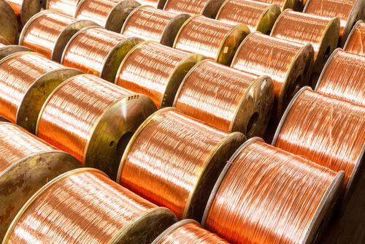
In this Smart Lesson you will learn to:
Recall that electrical conductors have discrete electric charge carriers that are free to move.
Distinguish between conductors and insulators.
Explain how metals, insulators and semiconductors have different levels of conductivity.

Slide 3
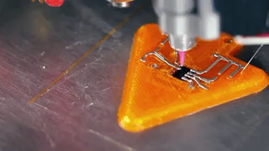
Conduction.
Conduction is defined as the process by which heat or electricity is directly transferred or transmitted through the material of a substance when there is a difference of temperature or of electrical potential between adjoining regions, without movement of the material.
In this Smart Lesson we will be looking at electrical conduction.

Slide 4
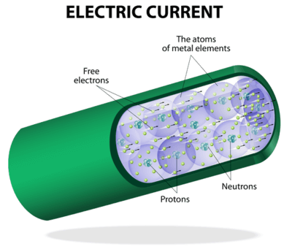
Conductors
A material which allows discrete electric charge carriers, such as electrons, to move through it easily is a conductor. They have a large number of free (delocalised) electrons or ions.
Electric charge carriers in a conductor will move when they have a large potential energy. The movement of electrons is called a current.
Examples of good conductors are copper, gold, and graphite. Worse conductors are water, sugar, and the human body.

Slide 5
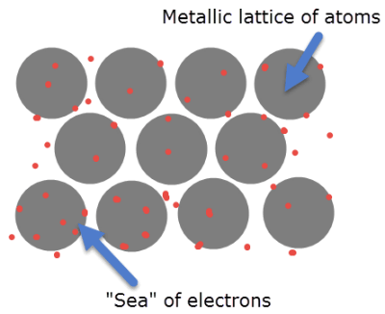
Metals are good examples of conductors.
This is because their atomic metal lattice structure unbinds the outer electron shells of the metal atoms. Metals are a lattice of positive ions surrounded by a 'sea' of electrons. This makes them very good at carrying an electron current.
At higher temperatures, metals become worse conductors as the ions and electrons become more energetic and move more. This makes them collide more often and so current can't flow as well.

Slide 6
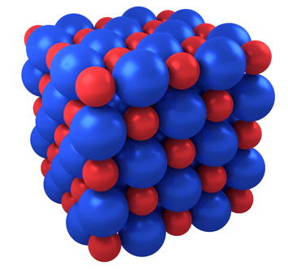
Insulators are materials that do not let a current flow, due to their lack of free electric charge carriers.
They are made up of atoms trapped in ionic or covalent bonds where the electrons are strongly held in bonding pairs. This makes it difficult to create a current because there are no free electrons or ions available.
With lots of energy the electrons can be freed, but the materials tend to melt or become damaged. Melted insulators are generally good conductors.
Examples of insulators are glass, rubber and dry air.

Slide 7
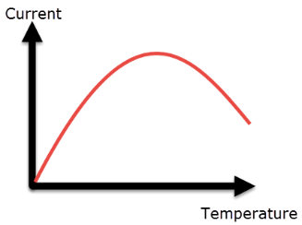
Semiconductors are materials with very low amounts of free electrons at room temperature, but which gain more as temperature increases.
They have similar structures to insulators, but the bonding electrons are held less strongly.
At too high a temperature, however, the same effect as in metals occurs. This means that at too hot or too cold a temperature they will become poor conductors, but there is a peak in the middle where they become excellent conductors.
Examples of semiconductors include silicon, germanium and gallium.

Slide 8
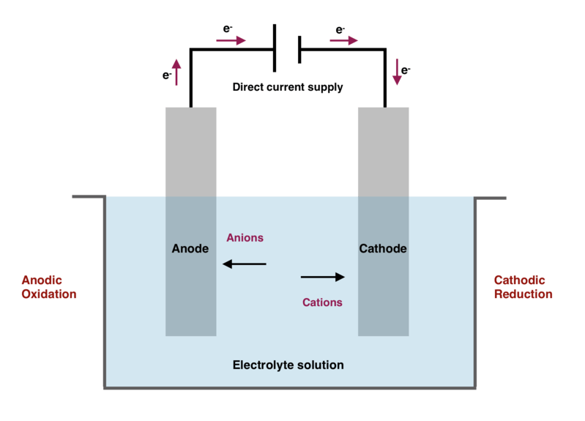
Ionic solutions also can conduct electricity.
This is because the ions in the solutions are free to move and are attracted towards the electrodes.
This process results in chemical changes and is known as electrolysis.

Slide 9
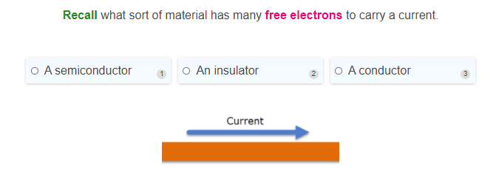

Slide 10
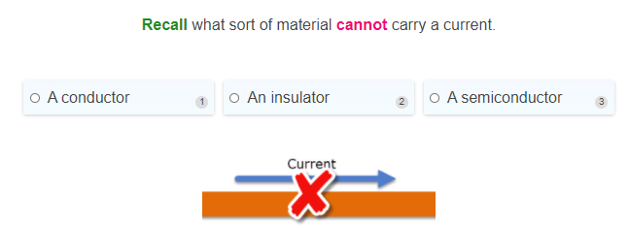

Slide 11
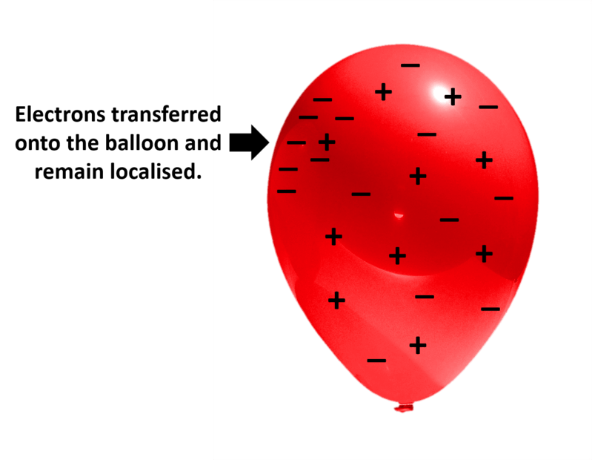
What happens if electrons are transferred to an insulator?
If electrons are added to an object, they will repel each other and spread out. In an insulator, they are unable to spread out and the negative charge will remain in one place.

Slide 12
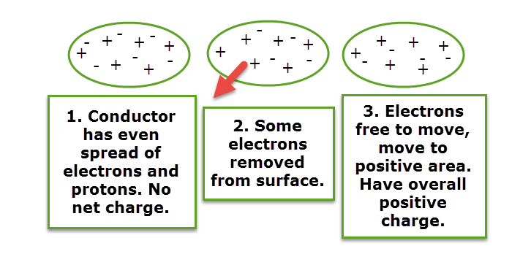
What happens when electrons are transferred to a conductor?
In a conductor, the electrons will easily spread across the object's surface to create an even distribution. If electrons are removed then the positive charge attracts electrons from other atoms, again evenly distributing the charge.

Slide 13
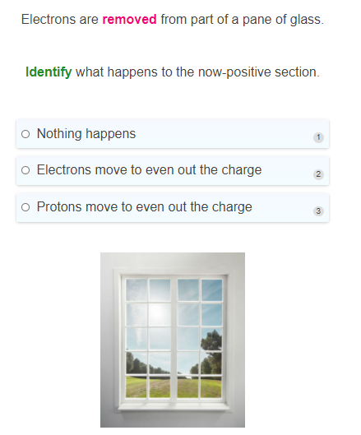

Slide 14
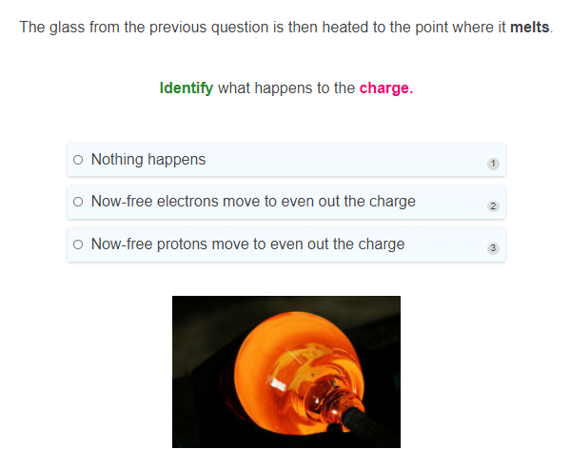

Slide 15
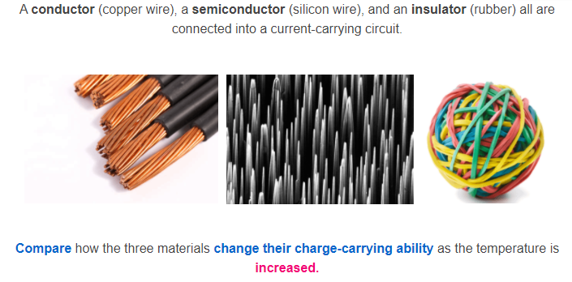

Slide 16
